Slide 1
Introduction to Palantir Foundry

Slide 2
What Is Foundry?
The Foundry Platform is a central, secure, and extensible platform where engineers, data scientists, analysts, and executives engage daily to capture and transform data, generate insights, and collaborate to make critical
data-driven decisions.
Foundry gives you the infrastructure to unite your disparate data sources into one central repository, making data of all types and all origins accessible across your organization.
Branched data pipeline authoring lets users build multiple views of the same data, and data provenance and versioning ensure transparency into how new data is derived.
Foundry provides a set of tools, integrated with the data ecosystem, for analysis and building applications and reports. As an open platform, Foundry also lets you export data and connect to third-party applications already in use at your organization.

Slide 3
What Can You Do in Foundry?
Discover data across your organization.
Data is centralized and searchable in Foundry. Foundry becomes the starting place for all data-driven questions in your organization.
View and explore any data available to you.
Data is accessible to every user, regardless of technical skill level. Foundry offers a unified and user-friendly interface for viewing any structured data in your organization.
Analyze and combine data at scale.
Foundry enables you to work with massive datasets, slicing, transforming, and aggregating data just as easily as if you were working with a spreadsheet on your desktop
Contribute data back into your organization.
A straight derivation from an enterprise data source you standardize the messy values in a column in a way that makes the distribution of values easier to understand.
Build on the data in your organization.
Foundry dramatically accelerates the ability to build new tools and get them in front of the business analysts who need them.

Slide 4

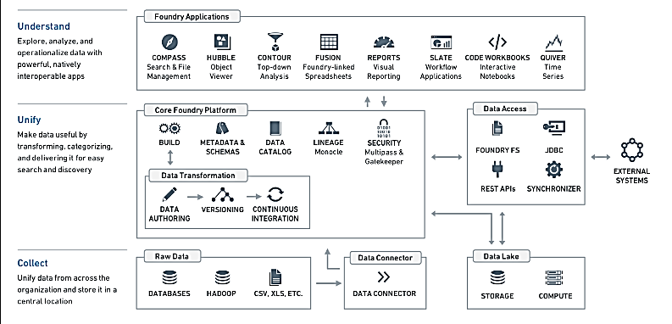
How palantir Foundry Work?

Slide 5
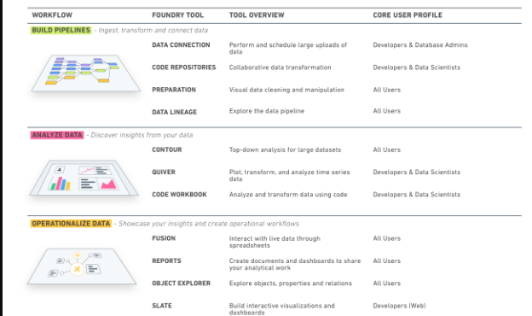
Know About Foundry Tools

Slide 6
Thank you

